Slide 1
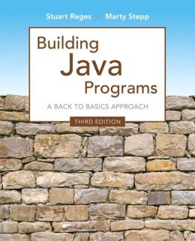
CS 210 Winter 2014 Fundamentals of Computer Science I
Building Java Programs Chapter 2:
Programming
Project 3

Slide 2
Chapter 2 Programming Project 3
Write a program that produces the following output:
+---------+
| * |
| /*\ |
| //*\\ |
| ///*\\\ |
| \\\*/// |
| \\*// |
| \*/ |
| * |
+---------+
| \\\*/// |
| \\*// |
| \*/ |
| * |
| * |
| /*\ |
| //*\\ |
| ///*\\\ |
+---------+

